Slide 1
New Luxury Condominium Development
IBM Data Science Professional Certificate
Capstone Project

Slide 2
Finding a location
The purpose of this investigation is to determine the best location to build a new luxury condominium complex in the D.C. Metro Area
Target client: Young professionals (single and couples)
The target price for these units will be between $500,000- $750,000 depending on the square footage and specifications of the unit
Community should be accessible to D.C. and provide easy access to amenities such as bars and restaurants

Slide 3
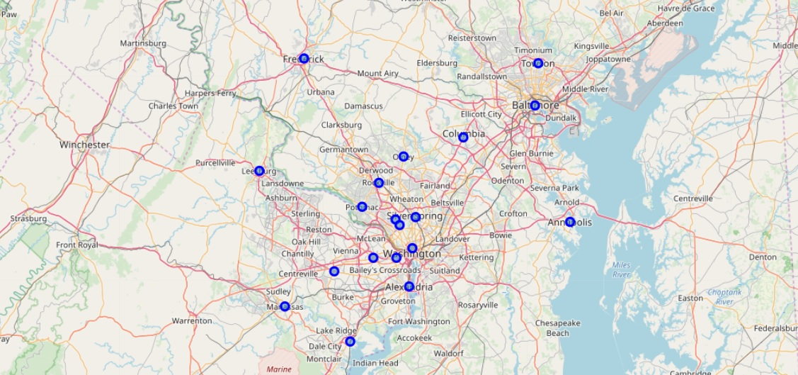
Initial Data
Using data from the U.S. Census Bureau, twenty cities, suburbs, and neighborhoods were selected for the investigation
Median income, property values, and median ages were loaded into a CSV file for processing with Watson Studio
Location data was collected for future analysis

Slide 4
State | City | Med Age | Med Income | Med Prop Value | Population | Latitude | Longitude
MD | Baltimore | 35.5 | 51000 | 167800 | 619493 | 39.2904 | -76.6122
MD | Columbia | 37.7 | 103707 | 367600 | 99615 | 39.2037 | -76.861
MD | Frederick | 35.3 | 67828 | 255100 | 71408 | 39.4143 | -77.4105
MD | Hagerstown | 34.6 | 40761 | 148300 | 40306 | 39.6418 | -77.72
DC | D.C. | 33.9 | 85203 | 617900 | 633427 | 38.9072 | -77.0369
VA | Arlington | 34.4 | 112138 | 634300 | 234965 | 38.8816 | -77.091
VA | Alexandria | 36.4 | 93370 | 537900 | 144301 | 38.8048 | -77.0469
MD | Bethesda | 43.4 | 154559 | 877300 | 63374 | 38.9847 | -77.0947
VA | Fairfax | 39 | 106870 | 501900 | 22549 | 38.8462 | -77.3064
VA | Manassas | 33.5 | 77551 | 307000 | 39300 | 38.7509 | -77.4753
VA | Falls Church | 39.7 | 114795 | 742000 | 12751 | 38.8823 | -77.1711
VA | Woodbridge | 39.7 | 102844 | 333600 | 54275 | 38.6582 | -77.2497
VA | Leesburg | 34.8 | 105844 | 394000 | 54215 | 39.1157 | -77.5636
MD | Chevy Chase | 46.3 | 173333 | 897000 | 9381 | 38.9693 | -77.0789
MD | Potomac | 47.3 | 187568 | 893600 | 44865 | 39.0182 | -77.2086
MD | Rockville | 38.6 | 100436 | 498200 | 68401 | 39.084 | -77.1528
MD | Silver Spring | 34.6 | 76608 | 477800 | 71452 | 38.9907 | -77.0261
MD | Olney | 42.1 | 136786 | 491300 | 33844 | 39.1532 | -77.0669
MD | Towson | 33.6 | 82062 | 345500 | 55197 | 39.4015 | -76.6019
MD | Annapolis | 37.4 | 81143 | 395900 | 39321 | 38.9784 | -76.4922

Slide 5
Initial Processing
Based on initial comparisons and statistical analyses, Arlington, Columbia, Alexandria, Fairfax, Falls Church, Leesburg, Rockville emerge as top contenders for the new development.

Slide 6
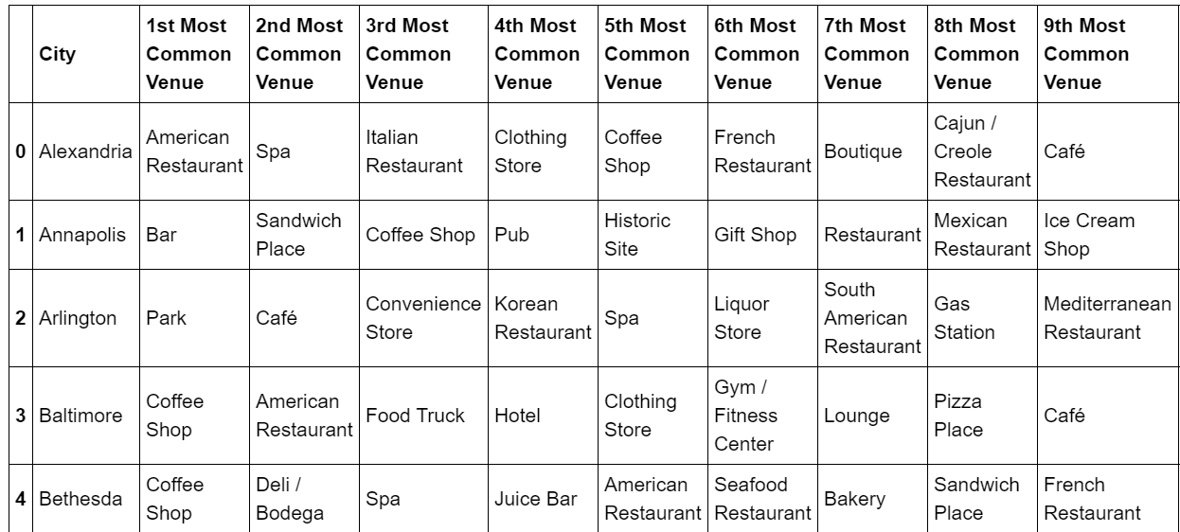
Locations
To determine the best neighborhoods for young professionals, data was collected from the Foursquare API
Generate the frequency of different venue types
Top rated venues at each location
Most common venues

Slide 7
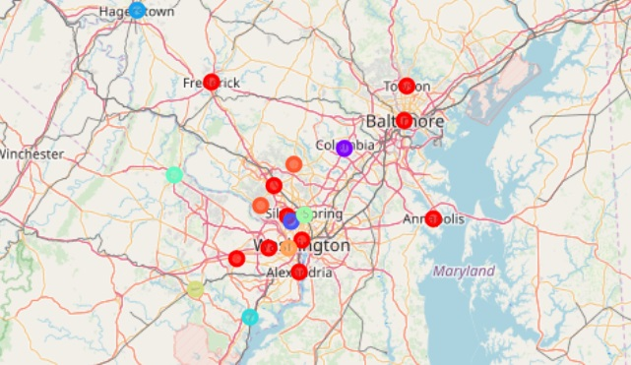
K-Means Clustering
K-Means clustering was used to group similar neighborhoods together
Results produced “Cluster 0” which was most attractive to young professionals

Slide 8
Cluster 0
Name | Most Common | Second | Third | Fourth | Fifth
Baltimore | Coffee Shop | Amer. Restaurant | Food Truck | Hotel | Clothing Store
Frederick | Amer. Restaurant | Park | Coffee Shop | Art Gallery | Bar
D.C. | Hotel | Amer. Restaurant | Hotel Bar | Coffee Shop | Salad Place
Alexandria | Amer. Restaurant | Spa | Italian Restaurant | Clothing Store | Coffee Shop
Bethesda | Coffee Shop | Deli | Spa | Juice Bar | Amer. Restaurant
Fairfax | Pizza | Yoga Studio | Smoothie Bar | Restaurant | Record Shop
Falls Church | Bar | Italian Restaurant | Grocery Store | Chinese Restaurant | Coffee Shop
Rockville | Bakery | Ice Cream Shop | Coffee Shop | Salon | Bubble tea
Towson | Cosmetic Store | Amer. Restaurant | Pizza | Café | Jewelry Store
Annapolis | Bar | Sandwich Shop | Coffee | Pub | Historic Site
Cluster 0

Slide 9
Comparisons
Based on clustering and initial data 3 finalists emerge: Rockville, Alexandria, Falls Church
These locations were examined in detail using tips, recommendations, and insights from foursquare.

Slide 10
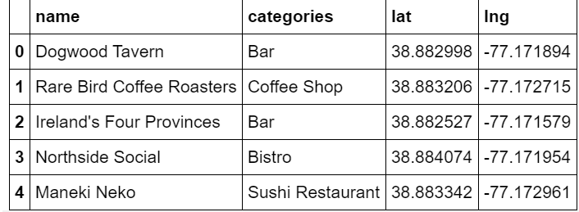
Final Result: Falls Church, VA

